Slide 1
Pandas, Part 2
LECTURE 4
Advanced Pandas syntax, aggregation, and joining
Sean Kang

Slide 2
Announcements
“method” and “function” are used interchangeably by many python and sw engineers.
For example:
df.value_counts() is a method. It is also a function.

Slide 3
Quick review from last lecture

Slide 4
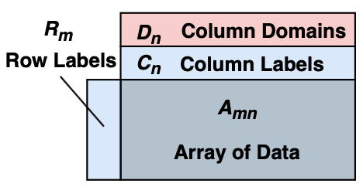
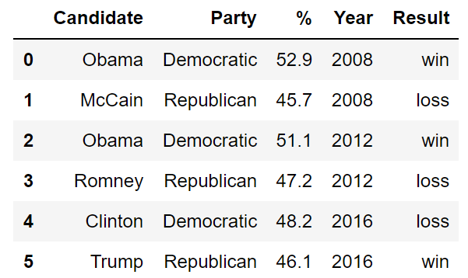
The world, a statistician's view
Features
🌍
A (statistical) population from which we draw samples.
Each sample has certain features.
Samples
A generic DataFrame
(from https://arxiv.org/abs/2001.00888)
Notes:
https://arxiv.org/abs/2001.00888

Slide 5
The Relationship Between Data Frames, Series, and Indices
We can think of a Data Frame as a collection of Series that all share the same Index.
Candidate, Party, %, Year, and Result Series all share an index from 0 to 5.
Candidate Series
Party Series
% Series
Year Series
Result Series
Non-native English speaker note: The plural of “series” is “series”. Sorry.

Slide 6
DataFrame access: [], loc, iloc
[]: flexible, confusing?
loc: Labels
iloc: integer/positional
Strings, integers - row/column labels
Lists - similar, but always return dataframes
Slices of labels: end-point inclusive!
Boolean arrays: “mask” selection.
Name
[]
Series
Single Column Selection
List
[[]]
DataFrame
Always 0-based, for rows and columns.
Slices as usual, end-point exclusive.
Use carefully (error prone).
Multiple Column Selection
Numeric Slice
[]
DataFrame
head, size, shape, and describe
(Multiple) Row Selection
Handy utilities to summarize a DF.

Slide 7
This Lecture: New Syntax / Concept Summary
Operations on String series, e.g. babynames[“Name”].str.startswith()
Creating and dropping columns.
Creating temporary columns is often convenient for sorting.
Passing an index as an argument to loc.
Useful as an alternate way to sort a dataframe.
Groupby: Output of .groupby(“Name”) is a DataFrameGroupBy object. Condense back into a DataFrame or Series with:
groupby.agg
groupby.size
groupby.filter
and more...
Pivot tables: An alternate way to group by exactly two columns.
Merge: A method to join two dataframes

Slide 8
Structure For Today
Today we’ll introduce additional syntax by trying to solve various practical problems on our baby names dataset.
Goal 1: Find the most popular name in California in 2018.
Goal 2: Find all names that start with J.
Goal 3: Sort names by length.
Goal 4: Find the name whose popularity has changed the most.
Goal 5: Count the number of female and male babies born in each year.
Notes:
Find election winners who lost the popular vote.

Slide 9
str

Slide 10
Manipulating String Data
Goal 1: Find all rows where the Name starts with J.
One way using just the Python would be to use a list comprehension to build a boolean array.
https://www.w3schools.com/python/python_lists_comprehension.asp

Slide 11
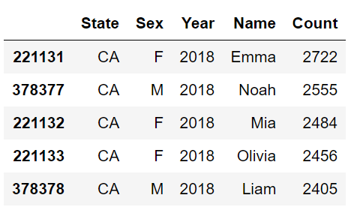
Manipulating String Data
Suppose we want to find all rows where the Name starts with J.
Approach 1: Use list comprehension
Create a list of booleans where ith entry is True if ith name starts with J.
Pass this list to [] or loc[].

Slide 12

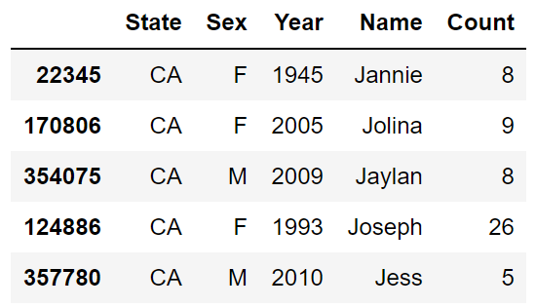


Manipulating String Data
Suppose we want to find all rows where the Name starts with J.
Approach 1: Use list comprehensions
Create a list of booleans where ith entry is True if ith name starts with J.
Pass this list to [] or loc[].
Goal: Fill the list comprehension ??? so that it returns the desired list.
Example list comprehension

Slide 13
Manipulating String Data
Suppose we want to find all rows where the Name starts with J.
Approach 1: Use list comprehensions
Create a list of booleans where ith entry is True if ith name starts with J.
Pass this list to [] or loc[].
Goal: Write a list comprehension that returns the desired list.

Slide 14
A More Advanced Approach
Approach 1: Use a list comprehensions.
Approach 2: Use a str method from the Series class (more on this shortly).
Question: What’s better about this second approach?
More readable! Others can understand your code.

Slide 15
Idiomatic Code
Approach 1: Use a list comprehensions.
Approach 2: Use a str method from the Series class (more on this shortly).
Terminology note: We say that approach #1 is not idiomatic.
Idiom: “the language peculiar to a people or to a district, community, or class.”
In other words, people from the broader pandas community won’t like reading your code if it looks like approach 1.

Slide 16
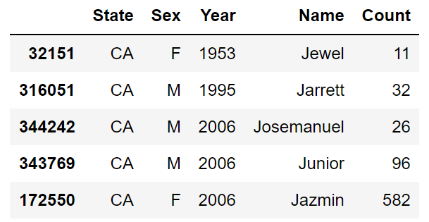
Str Methods
The str methods from the Series class have pretty intuitive behavior.
Won’t define formally. Doc in comments.
Example: str.startswith
Notes:
https://pandas.pydata.org/docs/reference/api/pandas.Series.str.html#

Slide 17
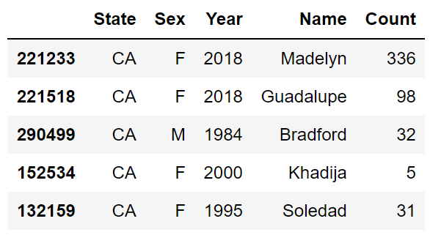
Str Methods
The str methods from the Series class have pretty intuitive behavior.
Won’t define formally.
Example: str.contains
Notes:
https://pandas.pydata.org/docs/reference/api/pandas.Series.str.html#

Slide 18
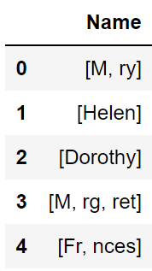
Str Methods
The str methods from the Series class have pretty intuitive behavior.
Won’t define formally.
Example: str.split

Slide 19
Challenge
Write a line of code that creates a list (or Series or array) of all names that end with “ert”.
Your list should have only one instance of each name!
Notes:
https://pandas.pydata.org/docs/reference/api/pandas.Series.str.endswith.html

Slide 20
Challenge
Write a line of code that creates a list (or Series or array) of all names that end with “ert”.
Your list should have only one instance of each name!

Slide 21
Adding, Modifying, and Removing Columns

Slide 22
Sorting By Length
Goal 3: Sort our baby names by length.
The sort_values function does not provide the ability to pass a custom comparison function.
Lots of weird ways to do this,
Let’s see two different ways of doing this that are much nicer.
Approach 1: Creating a temporary column, then sort on it.
Approach 2: Creating a sorted index and using loc.

Slide 23
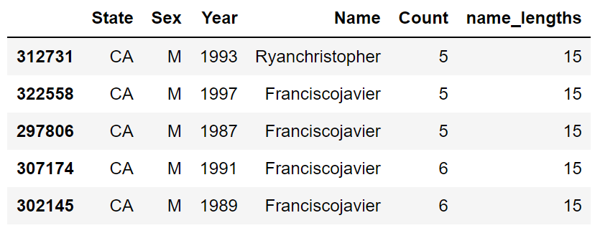
Approach 1: Create a Temporary Column
Intuition: Create a column equal to the length. Sort by that column.

Slide 24
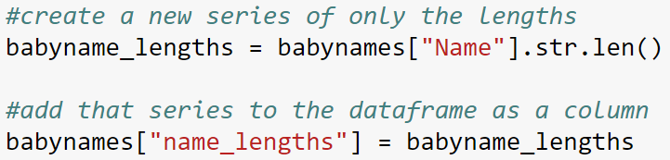
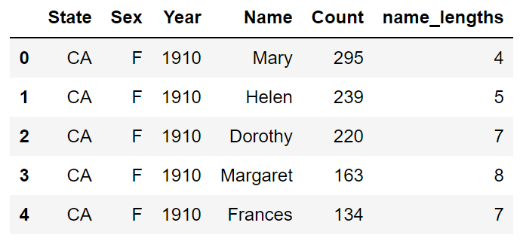
Syntax for Column Addition
Adding a column is easy:
Can also do both steps on one line of code

Slide 25
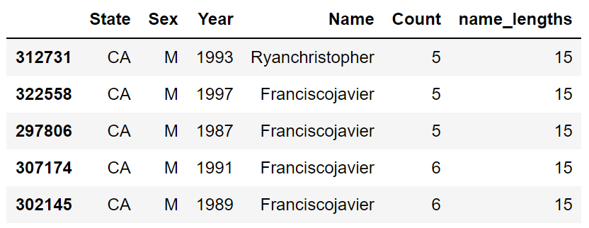
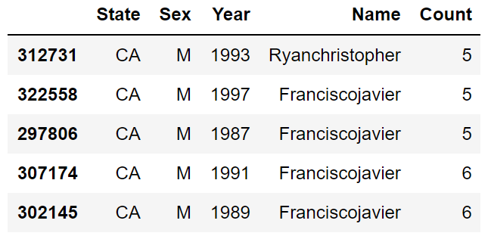
Syntax for Dropping a Column (or Row)
After sorting, we can drop the temporary column.
The Drop method assumes you’re dropping a row by default. Use axis = 1 to drop a column instead.

Slide 26
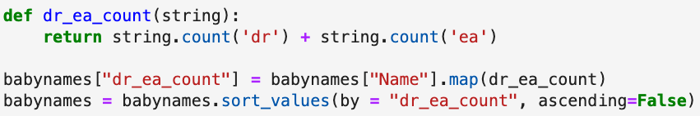
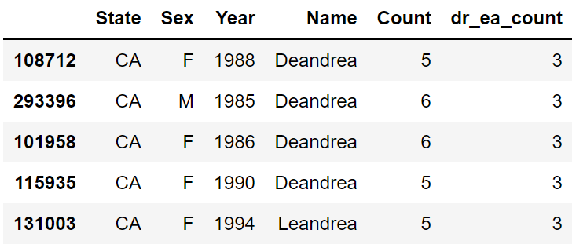
Sorting by Arbitrary Functions
Suppose we want to sort by the number of occurrences of “dr” + number of occurrences of “ea”.
Use the Series .map method.

Slide 27
A Little More .loc

Slide 28
Sorting By Length
Goal 3: Sort our baby names by length.
The sort_values function does not provide the ability to pass a custom comparison function.
Let’s see two different ways of doing this that are much nicer.
Approach 1: Creating a temporary column, then sort on it.
Approach 2: Creating a sorted index and using loc.

Slide 29
Approach 2: Create a Sorted Index and Pass to .loc
Another approach is to take advantage of another feature of .loc.
df.loc[idx] returns the DataFrame in the same order as the given index.
Only works if the index exactly matches the DataFrame.
Let’s see this approach in action.

Slide 30

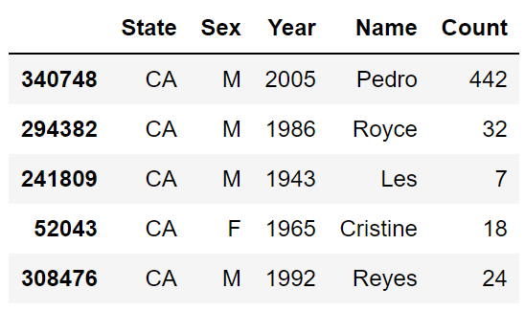
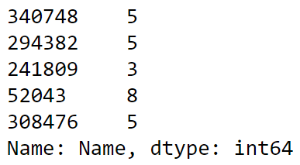
Approach 2: Create a Sorted Index and Pass to .loc
Step 1: Create Series of only the lengths of the names.
This Series will have the same index as the original DataFrame.
babynames
name_lengths

Slide 31
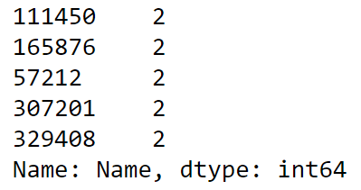
Approach 2: Create a Sorted Index and Pass to .loc
Step 2: Sort the series of only name lengths.
This Series will have an index which is reordered relative to the original dataframe.
name_lengths
name_lengths_sorted_by_length

Slide 32
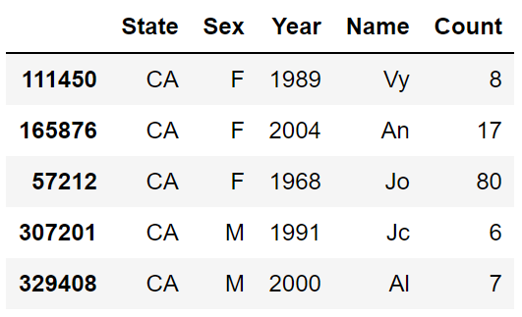
Approach 2: Create a Sorted Index and Pass to .loc
Step 3: Pass the sorted index as an argument of .loc to the original dataframe.
name_lengths_sorted_by_length
babynames.loc[index_sorted_by_length]

Slide 33
Another approach

Slide 34
Sorting By Length
Goal 4: Find the names that have changed the most in popularity.
Let’s start by defining what we mean by changed popularity.
In lecture, let’s stay simple and use the AMMD (absolute max/min difference): max(count) - min(count).
Example for “Jennifer”:
In 1954, there were only 5.
In 1972, we hit peak Jennifer. 6,066 Jennifers were born.
AMMD is 6,066 - 5 = 6,061.
Note: This is not a common term. I just made it up.

Slide 35

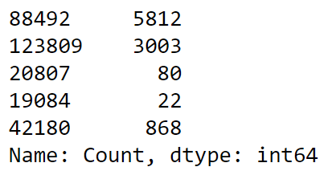


Example: Computing the AMMD for a Given Name

Slide 36
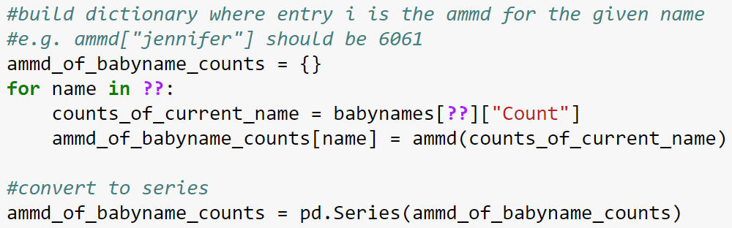
Approach 1: Getting AMMD for Every Name
Approach 1: Hack something together using our existing Python knowledge.
Challenge: Try to fill in the code above.

Slide 37
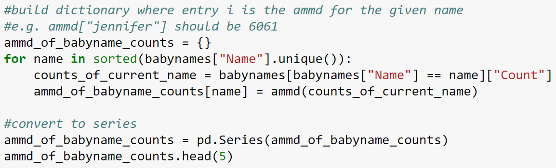
Approach 1: Getting AMMD for Every Name
Approach 1: Hack something together using our existing Python knowledge.

Slide 38
Quick Note
If this type of programming seems scary, don’t worry, you’ll get used to it.
Very different than the procedural style that you may be used to in Java, Matlab, Python, etc.
Has a more declarative/SQL like feel.

Slide 39
groupby Features

Slide 40
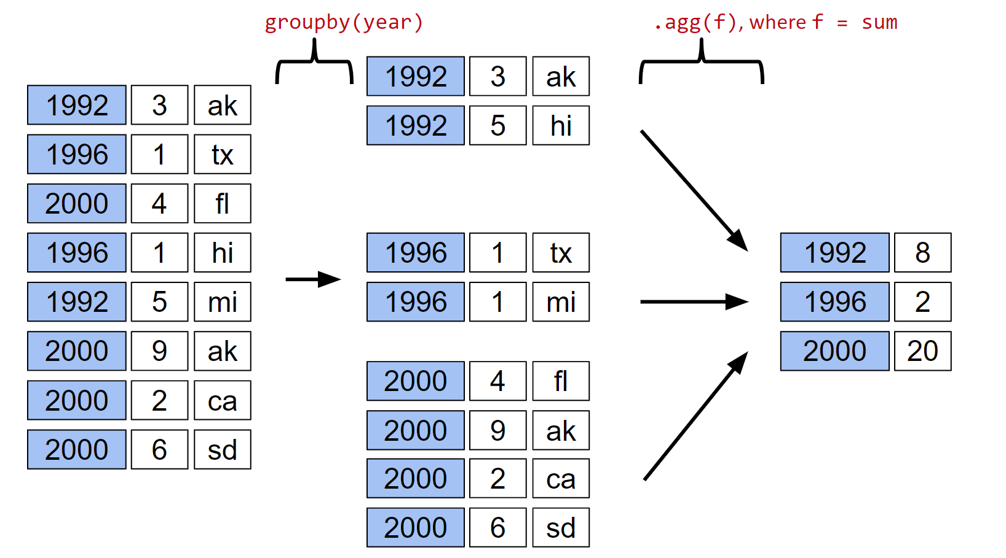
groupby.agg
df.groupby(“year”).agg(sum):
Organizes all rows with the same year into a subframe for that year.
Creates a new dataframe with one row representing each subframe year.
All rows in each subframe are combined using the sum function.

Slide 41
Raw groupby Objects
The result of a groupby operation applied to a DataFrame is a DataFrameGroupBy object.
It is not a DataFrame!
Given a DataFrameGroupBy object, can use various functions to generate DataFrames (or Series). Agg is only one choice:
agg: Creates a new DataFrame with one aggregated row per subframe.
size: Creates a new Series with the size of each subframe.
filter: Creates a copy of the original DataFrame, but keeping only rows from subframes that obey the provided condition.

Slide 42
groupby.size()
groupby(year)
.size()
1992
3
ak
1992
3
ak
1992
5
hi
1996
1
tx
2000
4
fl
1996
1
hi
1996
1
tx
1992
2
1992
5
mi
1996
1
mi
1996
2
2000
9
ak
2000
4
2000
4
fl
2000
2
ca
2000
9
ak
2000
6
sd
2000
2
ca
2000
6
sd

Slide 43
Filtering by Group
Another common use for groups is to filter data.
groupby.filter takes an argument f.
f is a function that:
Takes a DataFrame as input.
Returns either true or false.
For each group g, f is applied to the subframe comprised of the rows from the original dataframe corresponding to that group.

Slide 44
groupby.filter
groupby
.filter(f), where
f = lambda sf: sf[“num”].sum() > 10
A
3
A
3
A
1
B
1
A
2
6
C
4
B
1
B
1
C
4
A
1
B
5
12
B
5
B
5
B
6
C
9
C
9
13
A
2
B
6
C
4
D
5
C
9
5
B
6
D
5

Slide 45
groupby.sum(), groupby.mean(), groupby.max(), etc...
For common operations, rather than saying e.g. groupby.agg(sum), we can instead do groupby.sum():

Slide 46
groupby([]) and
Pivot Tables

Slide 47
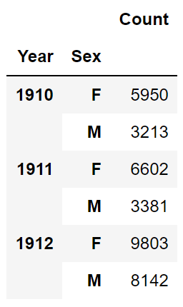
Grouping by Multiple Columns
Suppose we want to build a table showing the total number of babies born of each sex in each year. One way is to groupby using both columns of interest:
Example:
Note: Resulting DataFrame is multi-indexed. That is, its index has multiple dimensions. Will explore next week outside of lecture.

Slide 48
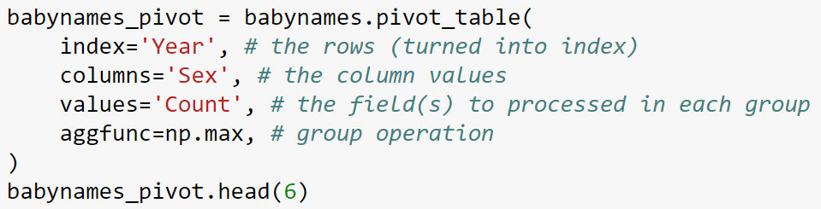
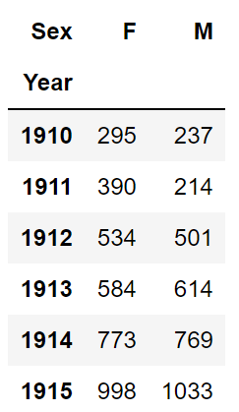
Pivot Tables
A more natural approach is to use a pivot table .

Slide 49
Joins and Merge

Slide 50
merge
Basic syntax for joining two dataframes df and df2
df.merge(df2)
Or df_output = pd.merge(df, df2)
Output is another dataframe
Pandas also has a method called join
limited version of merge
We will only use merge
Merge has many variations:
Left
Right
Outer
Inner
Cross

Slide 51
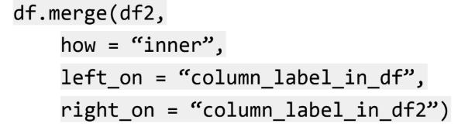
Types of Joins
As in SQL:
inner, outer, left, and right joins
Typical usage
“inner” can be replaced by “outer” or “left” or “right”
Notes:
https://pandas.pydata.org/docs/user_guide/merging.html

